Slide 1


Conceptual Architecture – Digital Decision Management Scenario: Make Reservation from Frontend Channel
CIAM
Channel Applications
System Mgmt.
Members
Channel Process Orchestration
(Mobile backend)
APIM
WIAM
Rule Management Platform
Decision
Services
(Stateless)
Rule Configuration
Application
Monitoring/Logging
Authenticate
Check Res. Eligibility
Get Carpark Label Qty.
Business Users
(Channels Team)
Role based
Access Control
Decision Metadata
(for decision)
CI/CD
Upload
(optional)
Integration Platform
Data Sync.
Product & Service Application
Product
Services
Product Metadata
Product Service – e.g. Check Outlet TBL availability
Product Service – e.g. Make Reservation
Product Configuration
Business Users
(Product Team)
CONFIDENTIAL

Slide 2
Technical Evaluation Scope
Rule Management Components
Core components
1. Rule Configuration
Create / update / delete rules
Rules conflict check
Rule testing
2. Decision Services
Generate APIs automatically
Provide Swagger like platform
API for eligibility check
API for rules query
3. Decision Metadata
Rules storage
Additional data supporting rule management
Data for reporting and audit trail
Cache for query
Security, Access Control
4. User Management
Authentication
Role based access control
User group access control by product/ service
CONFIDENTIAL

Slide 3
Technical Evaluation Scope
Non-functional Requirements
Core features
1. Deployment Mode
Demonstrate micro-service container packaging e.g. Docker and deploy in one of the native Cloud K8S platform (e.g. AWS EKS)
2. Scalability
Demonstrate the runtime instances can be dynamic scale out and scale in with sudden increase in workload
3. Admin Console
Demonstrate the business self-service portal for rules configuration
Demonstrate the admin console (for IT) to monitor the service healthiness
Integration Components
4. System Management
CI/CD integration
Application monitoring and logging
5. Ease of Integration
Demonstrate Event Driven Architecture (e.g. exposing APIs or messaging via JMS) by real-time configuration data (e.g. setting data in decision table) update from source system/s
Demonstrate other means of updating configuration data, e.g. excel/CSV sheet upload by business users
CONFIDENTIAL

Slide 4

Technical Evaluation Scope
1. Rule Configuration
Create rules
Test data 1: Racecourse Booking Price
RC_Price_v2.xls
# | Description | Input Values | Expected Output
1 | Input all values of race meeting table price as rules, then visualise using table format | All parameters in the table (e.g. RC, Outlet Name, Table Mini Charge, Buffet Charge) | A table showing the input values and rules
2 | Query a subset of rules for Table Mini Charge | Outlet Code, Box Number, Location Example “225081”, “B508”, “GI 5/F” | Table Mini Charge values Example Regular 2-person: $300, 4-person: $600 Special 2-person: $500, 4-person: $1000 HKIR 2-person: $700, 4-person: $1400
3 | Query a Table Mini Charge on a regular day | Outlet Code, Box Number, Location, # of persons, Date Example “22OB11”, “B101”, “G1 1/F”,5, “05/07/2022” | Table Mini Charge value Example $900
4 | Query a Table Mini Charge on a special day (New Year Day) | Outlet Code, Box Number, Location, # of persons, Date Example “22OB11”, “B101”, “G1 1/F”,5, “01/01/2022” | Table Mini Charge value Example $2700
CONFIDENTIAL

Slide 5

Technical Evaluation Scope
1. Rule Configuration
Create rules
Test data 2: Raceday Booking Schedule
Booking Schedule21-22(Oncourse+Tel)-20210615 (003).xlsx
# | Description | Input Values | Expected Output
1 | Input all values of raceday booking schedule, then visualise using table format | All parameters in the table (e.g. Date, Day, Race Course, On-course, By phone, Cancellation cut-off date/time) | A table showing the input values and rules
2 | Query the Cancellation Cut-Off Date/ Time on a specific day | Date, Race Course Example “13/07/2022”, “HV” | Cancellation Cut-Off Date/ Time Example “11/07/2022”, “Mon”, 15:00
3 | Check the eligibility of cancelling a booking | Date, Race Course, Cancellation Date, Cancellation Time Example “13/07/2022”, “HV”, “10/07/2022”, 12:00 | Eligibility for cancellation Example “Eligible”
4 | Check the eligibility of cancelling a booking | Date, Race Course, Cancellation Date, Cancellation Time Example “13/07/2022”, “HV”, “12/07/2022”, 12:00 | Eligibility for cancellation Example “Not eligible”
WIP: Some rules are not clear, TBC
CONFIDENTIAL

Slide 6
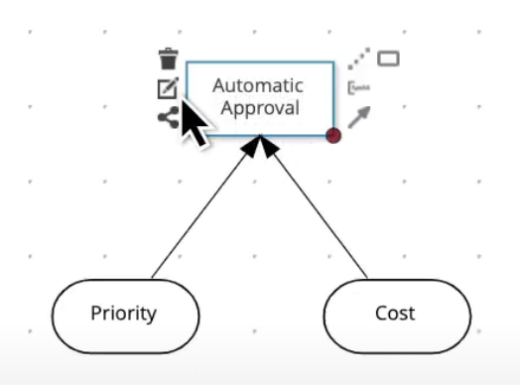
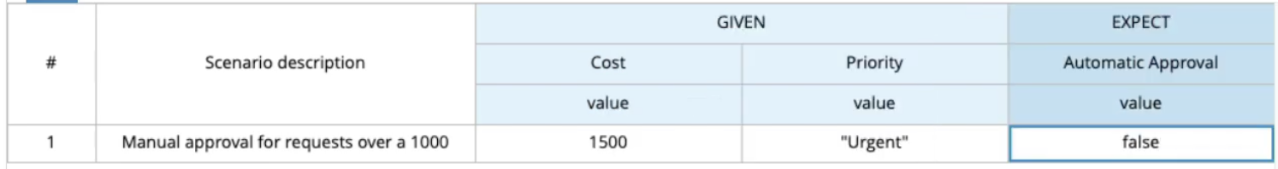
Technical Evaluation Scope
1. Rule Configuration
Create/ update/ delete rules
Intuitive user interface for business team to update/ delete rules
Examples
CONFIDENTIAL

Slide 7
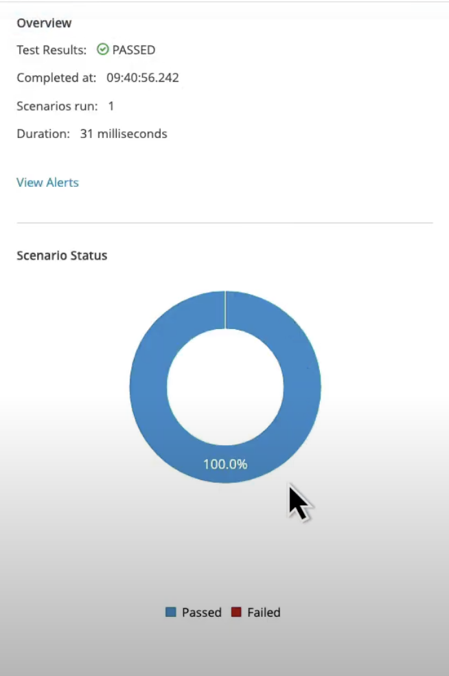
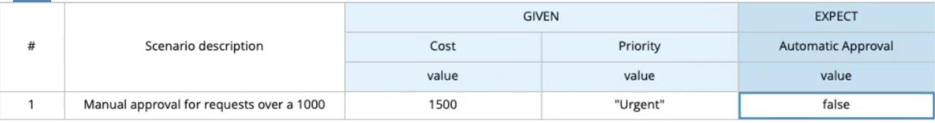
Technical Evaluation Scope
1. Rule Configuration
Rules conflict check
Conflict checking of rules e.g. duplicated rules, same rule created more than once
Conflict alert notifying users e.g. by email notification or on-screen alert?
Rules testing
Interface for testing rules
Examples
CONFIDENTIAL

Slide 8
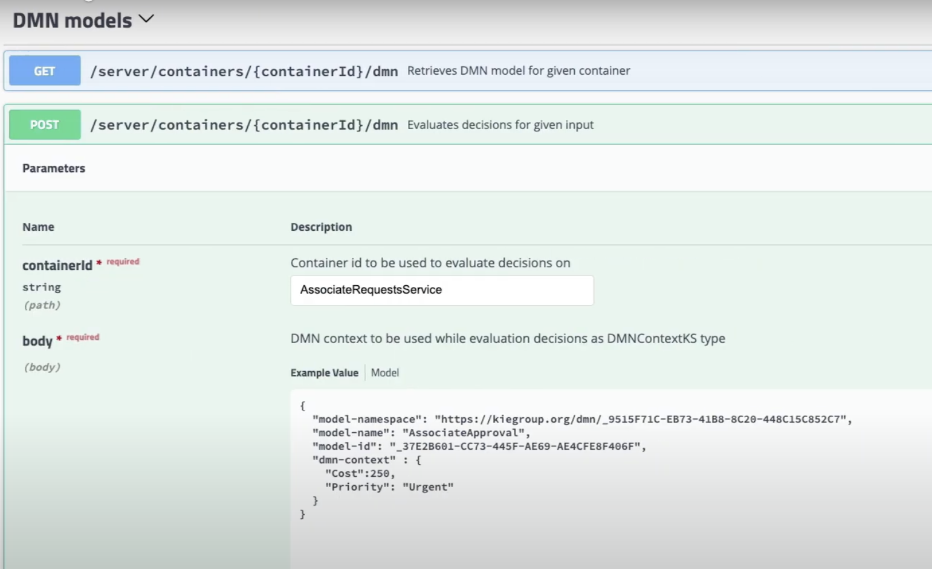
Technical Evaluation Scope
2. Decision Services
Generate APIs automatically
API can be generated from the rules stored automatically with versioning
Swagger like platform can be generated
APIs should include rules query, display all / subset of rules for channel front-end display
APIs should include rule eligibility check
Refer to 1. Rule Configuration / Create rules
Examples
CONFIDENTIAL

Slide 9
Technical Evaluation Scope
3. Decision Metadata
Rules storage
Master storage of all rules
Additional data supporting rule management
Data for reporting and audit trail e.g statistics of API calls, # of eligible/ non-eligible calls
Cache for rules query Refer to 1. Rule Configuration / Create rules
CONFIDENTIAL

Slide 10
Technical Evaluation Scope
4. User Management
Enable authentication or Single Sign-On
Integrate with the existing AD for SSO
Provide unified user access management mechanism across HKJC
Role based access control
Manage read, write rights of different sets of rules based on user roles
User group access control by product/ service
Group users by product/ service
Group rules by product/ service
Manage access rights based on product/ service groups
CONFIDENTIAL

Slide 11
Technical Evaluation Scope
5. System Management
CI/CD integration
Integrate with CI/CD tools
Rule configuration can trigger CI/CD process automatically includes building testing service generation deployment
Application monitoring and logging
Integrate with application monitoring and logging tools
Performance monitoring for API calls e.g. query response time
Query response code statistics
Alert on abnormal activities
CONFIDENTIAL

